Slide 1
How do you learn best?
Learning Style & Multiple Intelligence Inventories
Carson Fuchs

Slide 2
What is a learning inventory?
Learning inventories are a series of questions that determine what style of learning is best for you!

Slide 3
Why should I find out my learning style?
Every student learns differently.
Taking a learning inventory will help you to discover how you like to learn.
Each learning style has tips and tricks to help you learn better.

Slide 4
Why is it important for Miss Fuchs?
Knowing how you like to learn will help me to create class activities that work best for everyone! By teaching to your individual learning styles, I can create a happy and successful classroom!

Slide 5
Learning Style Inventory Directions:
Go to http://www.educationplanner.org/students/self-assessments/learning-styles.shtml
Click on the blue link that says, “Answer the 20 Questions”
Answer each by choosing the answer that sounds the most like you.
Click on the red apple to go to the next question.
Press submit after question #20 to get your results!

Slide 6
If you are an Auditory learner…
You learn best by hearing and listening.
Sit where you can hear.
Have your hearing checked on a regular basis.
Use flashcards to learn new words; read them out loud.
Read stories, assignments, or directions out loud.
Record yourself spelling words and then listen to the recording.
Have test questions read to you out loud.
Study new material by reading it out loud

Slide 7
If you are a Visual learner…
You learn by reading or seeing pictures.
Sit near the front of the classroom.
Use flashcards to learn new words.
Try to visualize things that you hear or things that are read to you.
Write down key words, ideas, or instructions.
Draw pictures to help explain new concepts and then explain the pictures.
Color code things.

Slide 8
If you are a Tactile learner…
You learn by touching and doing.
Participate in activities that involve touching, building, moving, or drawing.
Do lots of hands-on activities like completing art projects, taking walks, or acting out stories.
Use flashcards and arrange them in groups to show relationships between ideas.
Take frequent breaks during reading or studying periods (frequent, but not long).
It's OK to tap a pencil, shake your foot, or hold on to something while learning.
Use a computer to reinforce learning through the sense of touch

Slide 9
According to Howard Gardner, students can have multiple types of intelligences or learning styles.

Slide 10
Multiple Intelligence Inventory Directions:
Go to http://www.bgfl.org/custom/resources_ftp/client_ftp/ks1/ict/multiple_int/what.cfm
Click on the red “Take the Test” link
Select English
Fill out About Me info in Section 1

Slide 11
Answer the 40 questions in Section 2 with the answer that is most like you. Choose:
This is not like me at all
I am very rarely like this
This is a bit like me
This is sometimes like me
I am like this more often than not
I am always like this

Slide 12
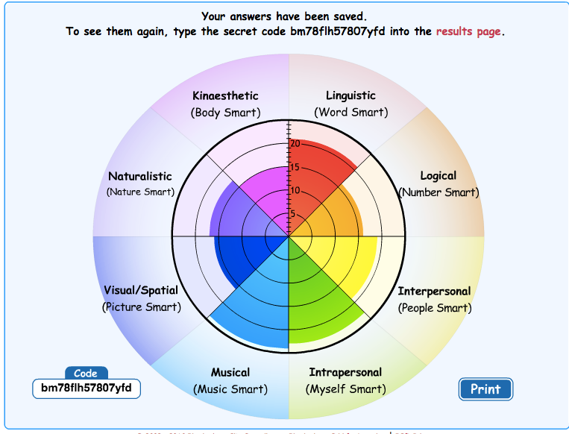
After you submit, a circle graph will appear…
Click results page and type in code
Save this code

Slide 13
You can determine how much of each intelligence by the number of colored rings in each category

Slide 14
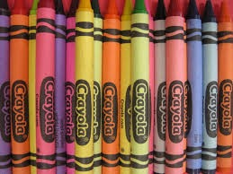
GARDNER’S MULTIPLE INTELLIGENCES
Naturalistic - Nature Smart
Musical - Music Smart
Logical - Number Smart
Linguistic - Word Smart
Interpersonal - People Smart
Intrapersonal - Myself Smart
Visual/Spatial - Picture Smart
Kinesthetic - Body Smart

Slide 15
References:
Maund, J. (n.d.). Birmingham Grid for Learning - Multiple Intelligences (Primary). Birmingham Grid for Learning - Multiple Intelligences (Primary). Retrieved March 23, 2016 from http://www.bgfl.org/bgfl/custom/resources_ftp/client_ftp/ks1/ict/multiple_int/what.cfm
What's Your Learning Style? (2011). Retrieved March 23, 2016, from http://www.educationplanner.org/students/self-assessments/learning-styles.shtml

